Slide 1
Attrition in the Workplace
A DDSAnalytics research project focused on minimizing employee attrition at Frito Lay

Slide 2
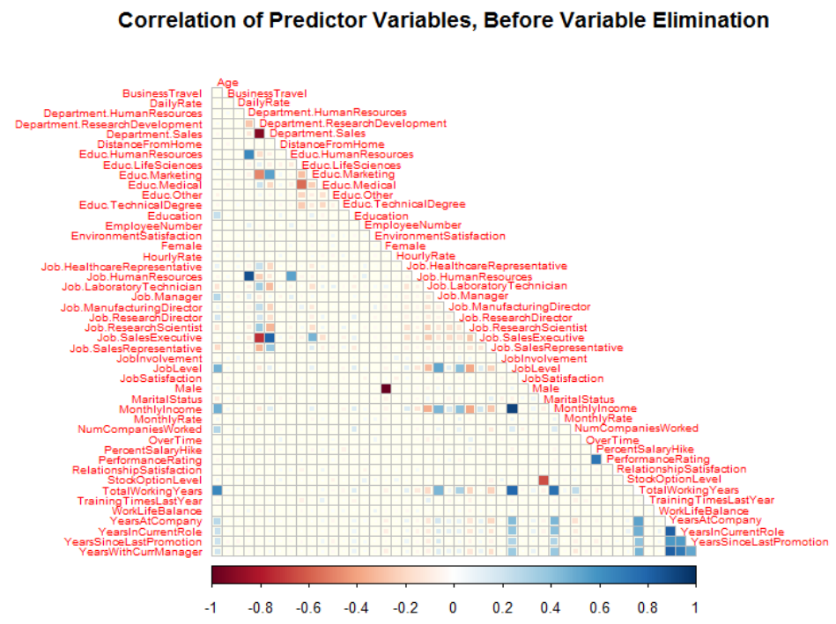
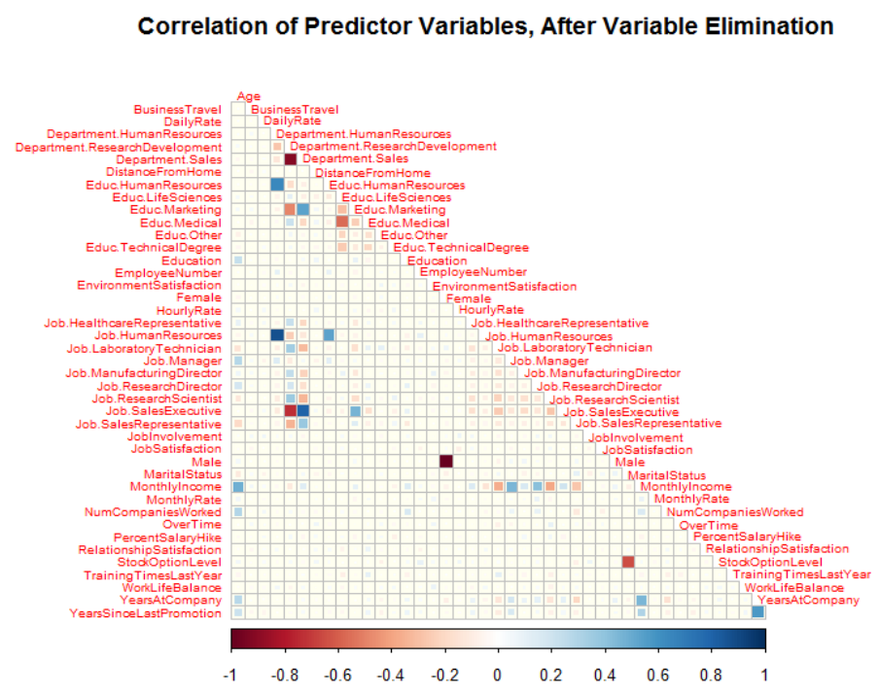
Correlated Predictors

Slide 3
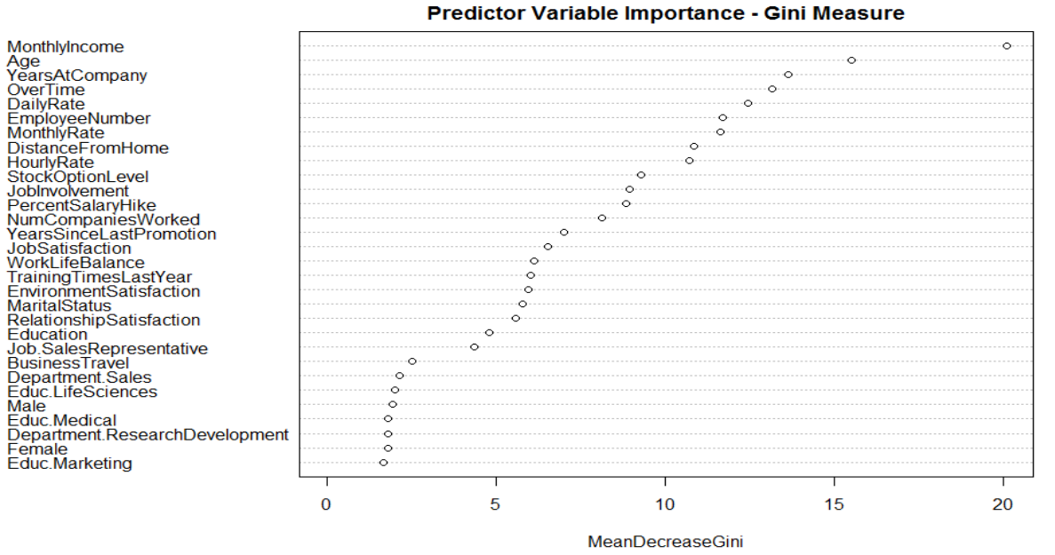
Important Factors for Attrition
Top Three Factors for Attrition:
Monthly Income
Age
Years at Company

Slide 4
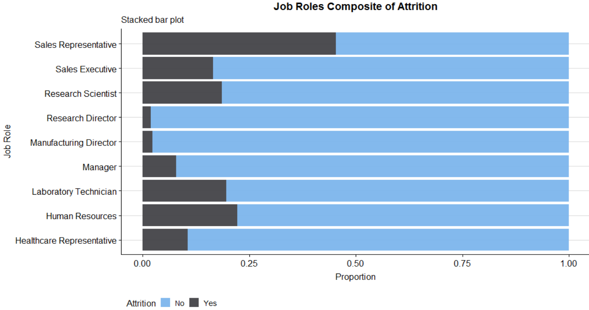
Job Roles vs. Attrition
Many roles have similar attrition rates, others do not
High Attrition: Sales Representatives
Low Attrition:
Research Director
Manufacturing Director

Slide 5
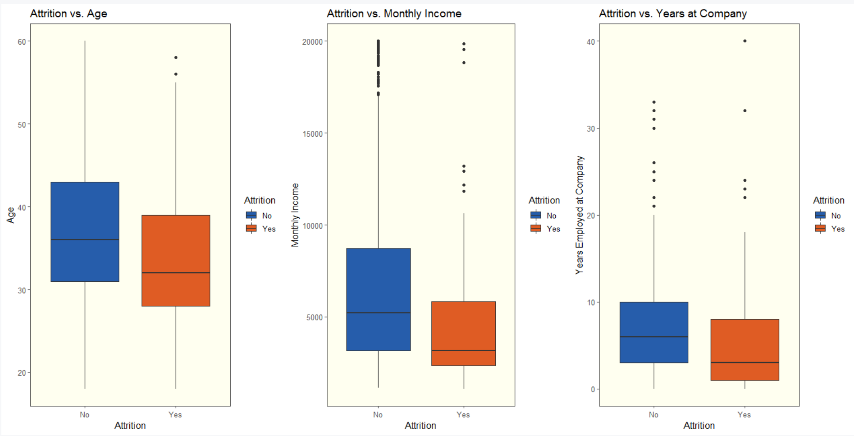
Top Three Factors vs. Attrition
Employment more constant from mid-thirties onward
Age and years employed at company roughly interchangeable
Higher pay = longer employment

Slide 6
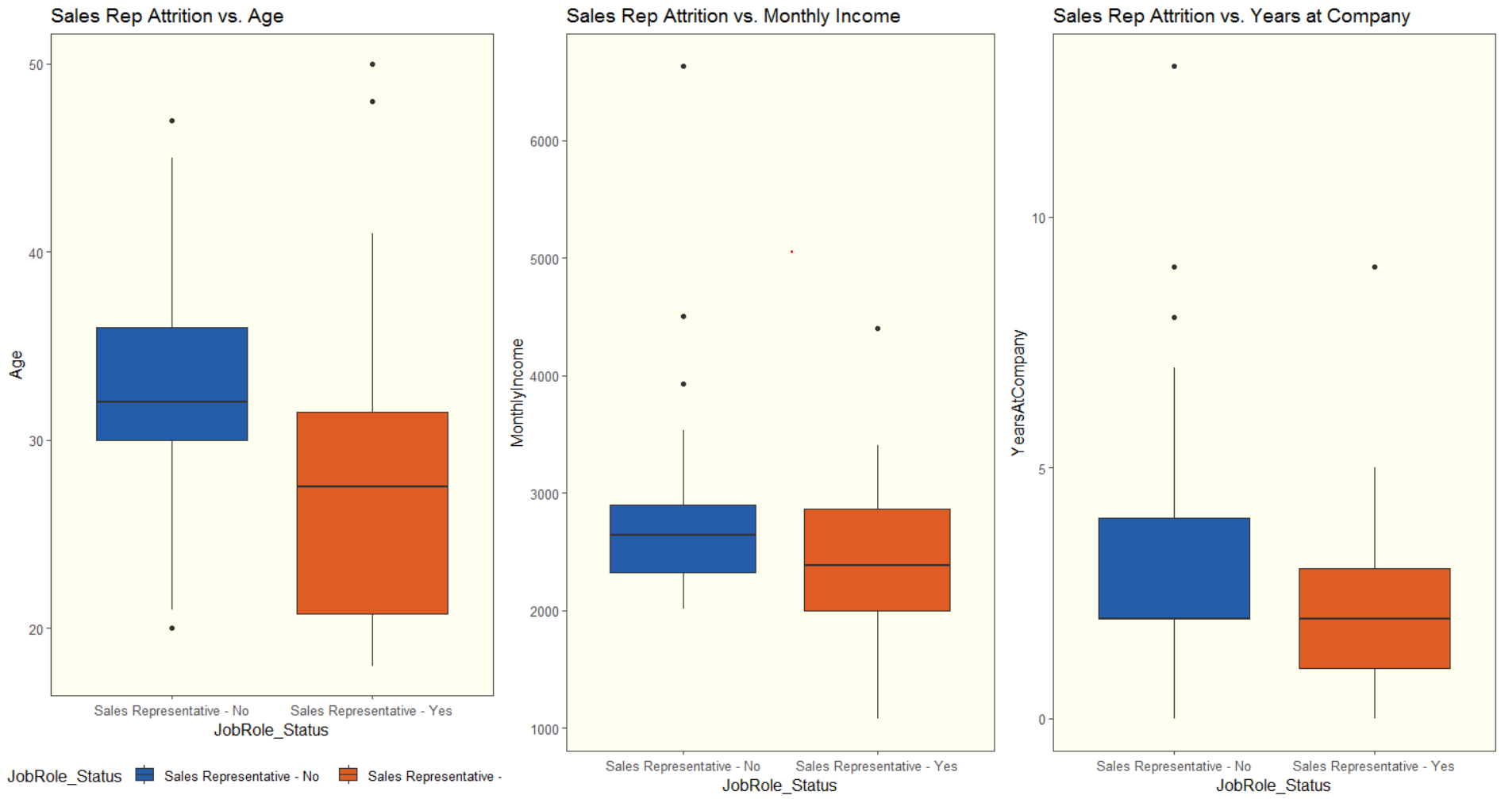
Highest Level of Attrition: Sales Representatives
Sales representatives the largest accounting for attrition
Young age
Lower income

Slide 7
Takeaways
Monthly Income the largest contributor to attrition
Age the second largest contributor to attrition
Attrition the third largest contributor to attrition
Job Satisfaction
Lest Satisfied: Sales Representatives
Most Satisfied: Research Director, Manufacturing Director
Naïve Bayes for predicting attrition
Multiple Linear Regression for predicting monthly income

Slide 8
Presentation Documentation
YouTube video for PowerPoint
https://youtu.be/803OW_EOIbc
GitHub repository for Project
https://github.com/PaulAdams4361/CaseStudy2DDS

